Slide 1
Implementasi Struktur Data t r e e
Program Studi Diploma III Teknik Informatika
Fakultas Ilmu Terapan
Universitas Telkom

Slide 2
Binary tree
Pohon Biner

Slide 3
Pohon Biner
Adalah kumpulan simpul yang mungkin kosong atau mempunyai akar dan dua subpohon yang saling terpisah (left subtree dan right subtree)
Derajat maksimal = 2
Complete binary tree tingkat N : pohon biner yang semua daunnya terdapat pada tingkat N dan semua simpul yang lebih kecil dari N pasti mempunyai cabang kiri dan kanan
Banyak simpul maksimum pada tingkat N = 2^{N-1}
Skewed binary tree : pohon biner yang banyaknya simpul cabang kiri tidak seimbang dengan banyak simpul cabang kanan

Slide 4
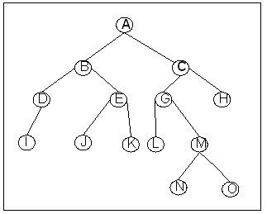
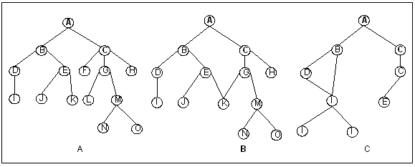
Contoh Pohon Biner :
Contoh Bukan Pohon Biner :
Mengapa ketiga pohon tsb tidak dapat disebut Pohon Biner ?

Slide 5
Representasi Binary Tree
Menggunakan pointer
Bentuk paling sederhana (one-way)
Data
Bentuk 2-way
Data
Bentuk yang lebih lengkap
Data

Slide 6
Representasi dengan Array
CBT dan PBT dapat diimplementasikan dalam array
Penomoran pada node-nodenya bersifat terurut dan tidak ada yang kosong (melompat).
A
0
1
B
I
2
3
C
4
F
5
J
K
6
D
E
G
H
7
9
10
8
Dalam Array
A
B
I
C
F
J
K
D
E
G
H
0
1
2
3
4
5
6
7
8
9
10

Slide 7
Representasi dengan Array
Contoh beberapa hubungan struktural representasi array :
Mendapatkan anak dari suatu node :
Anak kiri dari node I : I → 2I + 1
Anak kanan dari node I : I → 2I + 2
Mendapatkan ayah dari suatu node :
Ayah dari node I : I → [(I-1)/2]
Sibling dari node ke I :
I node genap : I-1
I node ganjil : I+1

Slide 8
Representasi dengan Linked List
class BinaryNode<T> {
private T data;
private BinaryNode<T> left;
private BinaryNode<T> right;
}
Data

Slide 9
BINARY SEARCH TREE

Slide 10
Binary Search Tree
For every node X in the tree, the values of all the keys in the left subtree are smaller than the key in X and the values of all the keys in the right subtree are larger than the key in X
The binary-search-tree property allows us to print out all the keys in a binary search tree in sorted order by inorder tree walk.

Slide 11
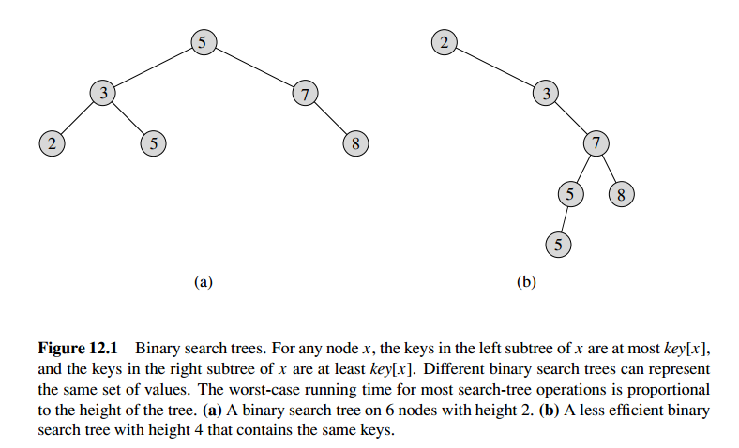

Slide 12
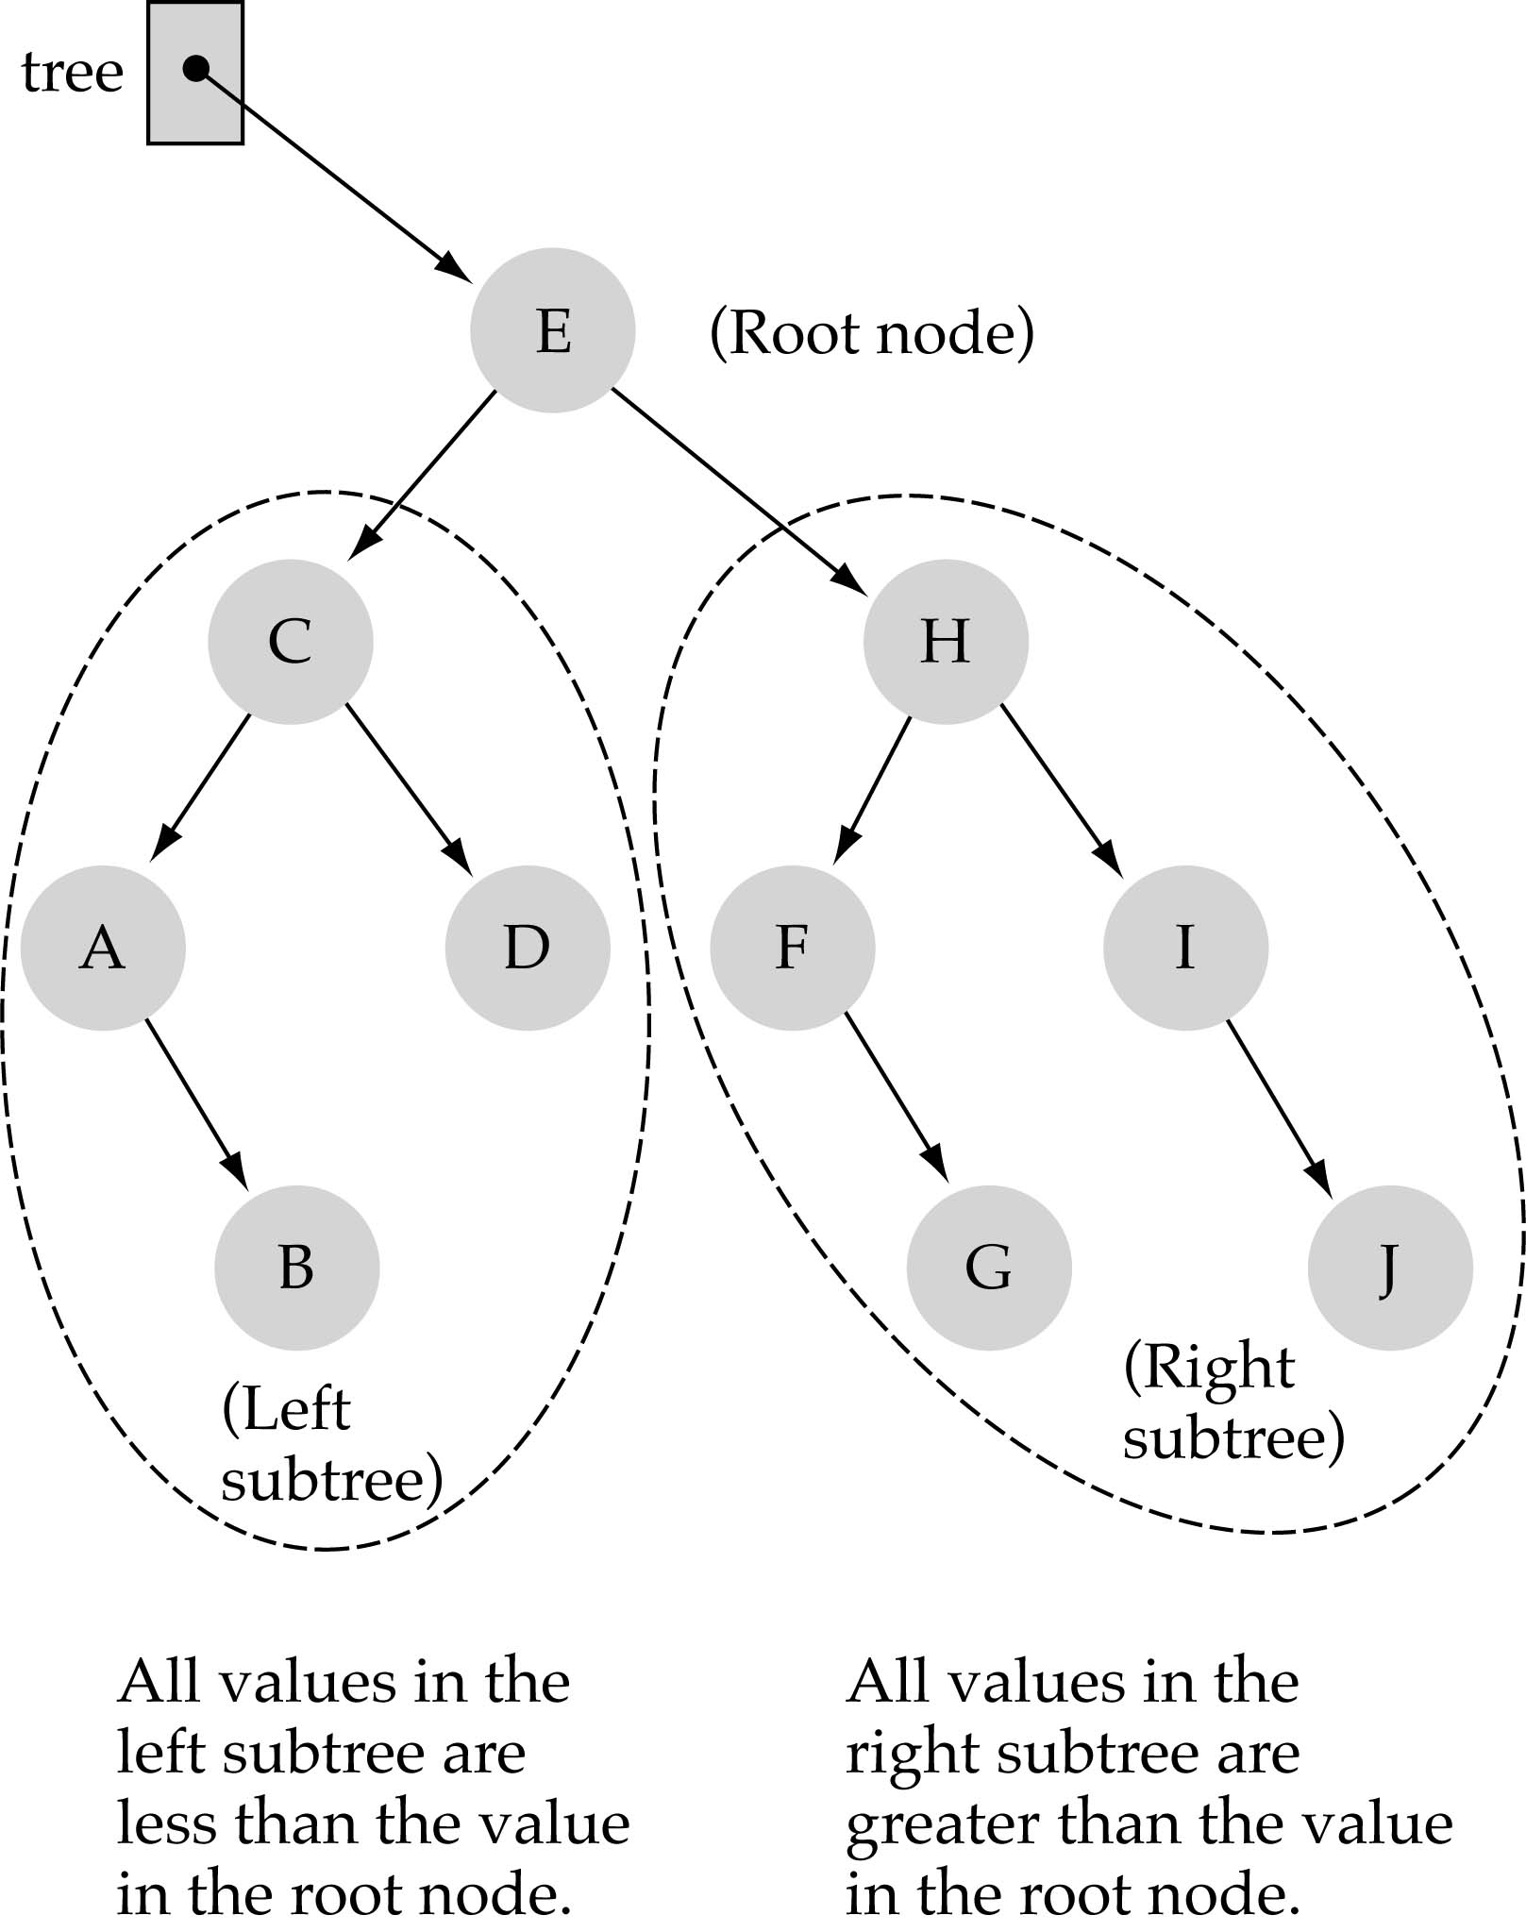
Binary Search Trees (BSTs)
In a BST, the value stored at the root of a subtree is greater than any value in its left subtree and less than any value in its right subtree

Slide 13
Binary Search Trees (BSTs)
Where is the smallest element?
Ans: leftmost element
Where is the largest element?
Ans: rightmost element

Slide 14
operasi pada BST
Searching
Insert
Delete
Find Minimum
Find Maximum
Look up Successor
Look up Predecessor
BST visualization : http://btv.melezinek.cz/binary-search-tree.html

Slide 15
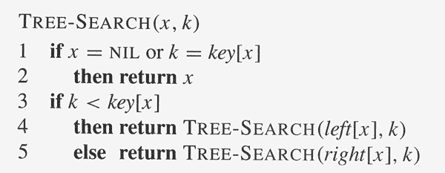
Algoritma Searching

Slide 16
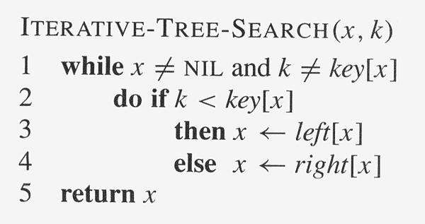
Algoritma Searching

Slide 17
How to search a binary search tree?
(1) Start at the root
(2) Compare the value of the item you are searching for with the value stored at the root
(3) If the values are equal, then item found; otherwise, if it is a leaf node, then not found

Slide 18
How to search a binary search tree?
(4) If it is less than the value stored at the root, then search the left subtree
(5) If it is greater than the value stored at the root, then search the right subtree
(6) Repeat steps 2-6 for the root of the subtree chosen in the previous step 4 or 5

Slide 19

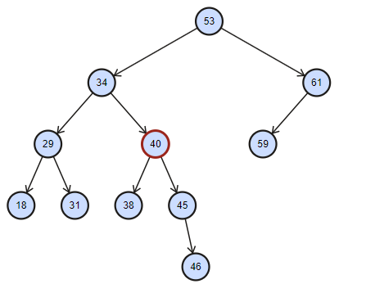


ExAMPLE

Slide 20
Insertion
Penyisipan sebuah elemen baru dalam binary search tree, elemen tersebut pasti akan menjadi leaf
Insert X into a binary search tree:
n start from the root.
If the value of X is less than the value of the root, then X should be inserted on the left sub-tree.
On the other hand, if the value of X is greater than the value of the root, then X should be inserted on the right sub-tree.
Remember that, a sub tree is also a tree. So, the problem to insert an element in the sub-tree is same as the problem to insert an element in the root.
Recursive approach.

Slide 21
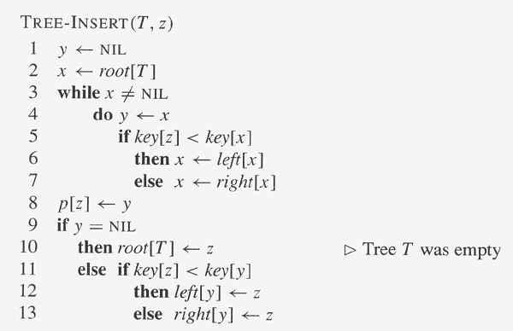
Insertion

Slide 22
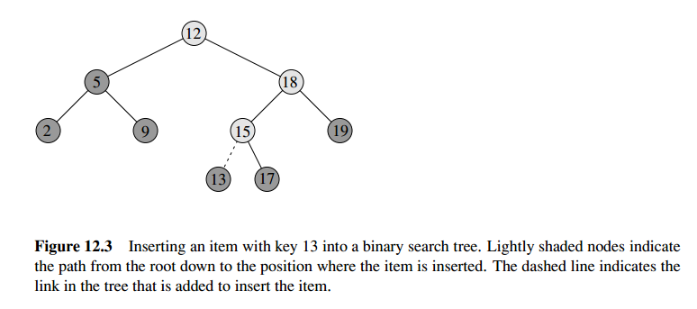

Slide 23



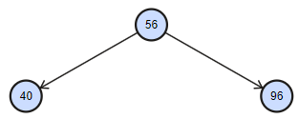
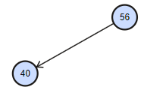

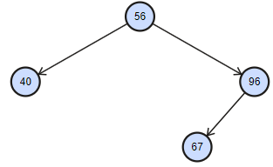

EXAMPLE

Slide 24
Find Minimum / Maximum
An element in a binary search tree whose key is a minimum can always be found by following left child pointers from the root until a NULL is encountered
The pseudocode for TREE-MAXIMUMis symmetric.
Kapan dipakai?
Menentukan Predecessor / Successor

Slide 25
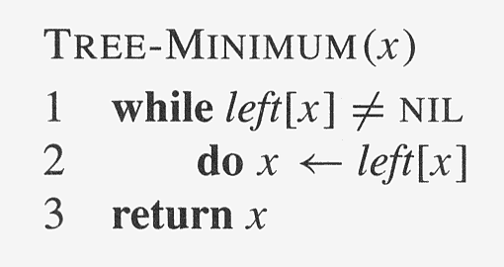
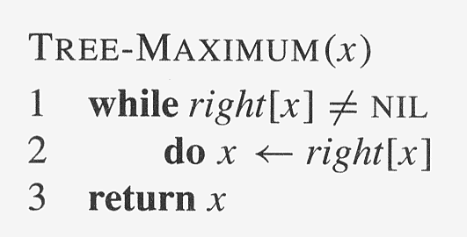

Slide 26
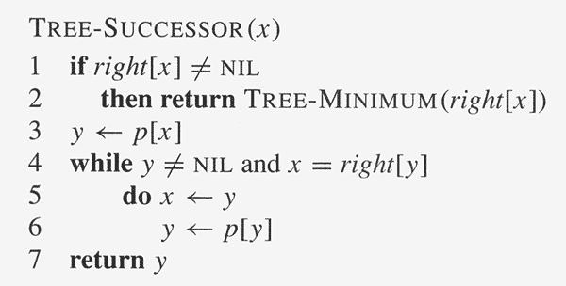

Slide 27
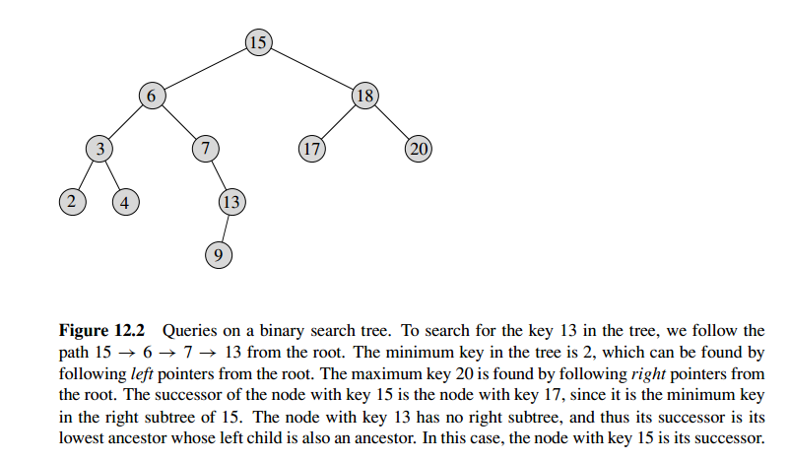

Slide 28
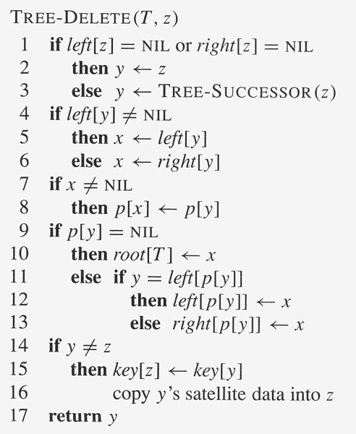
Deletion
Deletion in Binary Search Tree

Slide 29
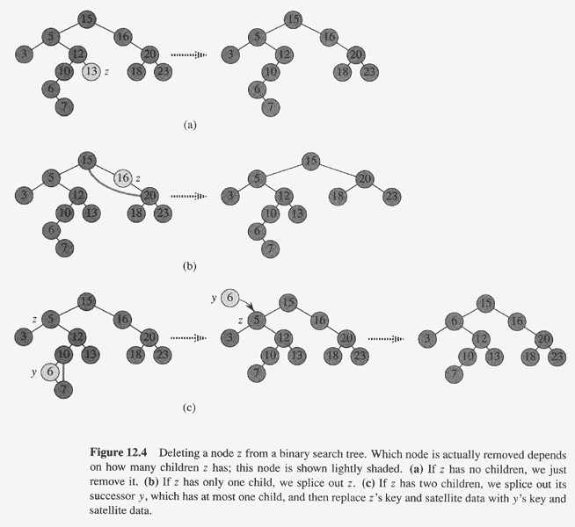

Slide 30
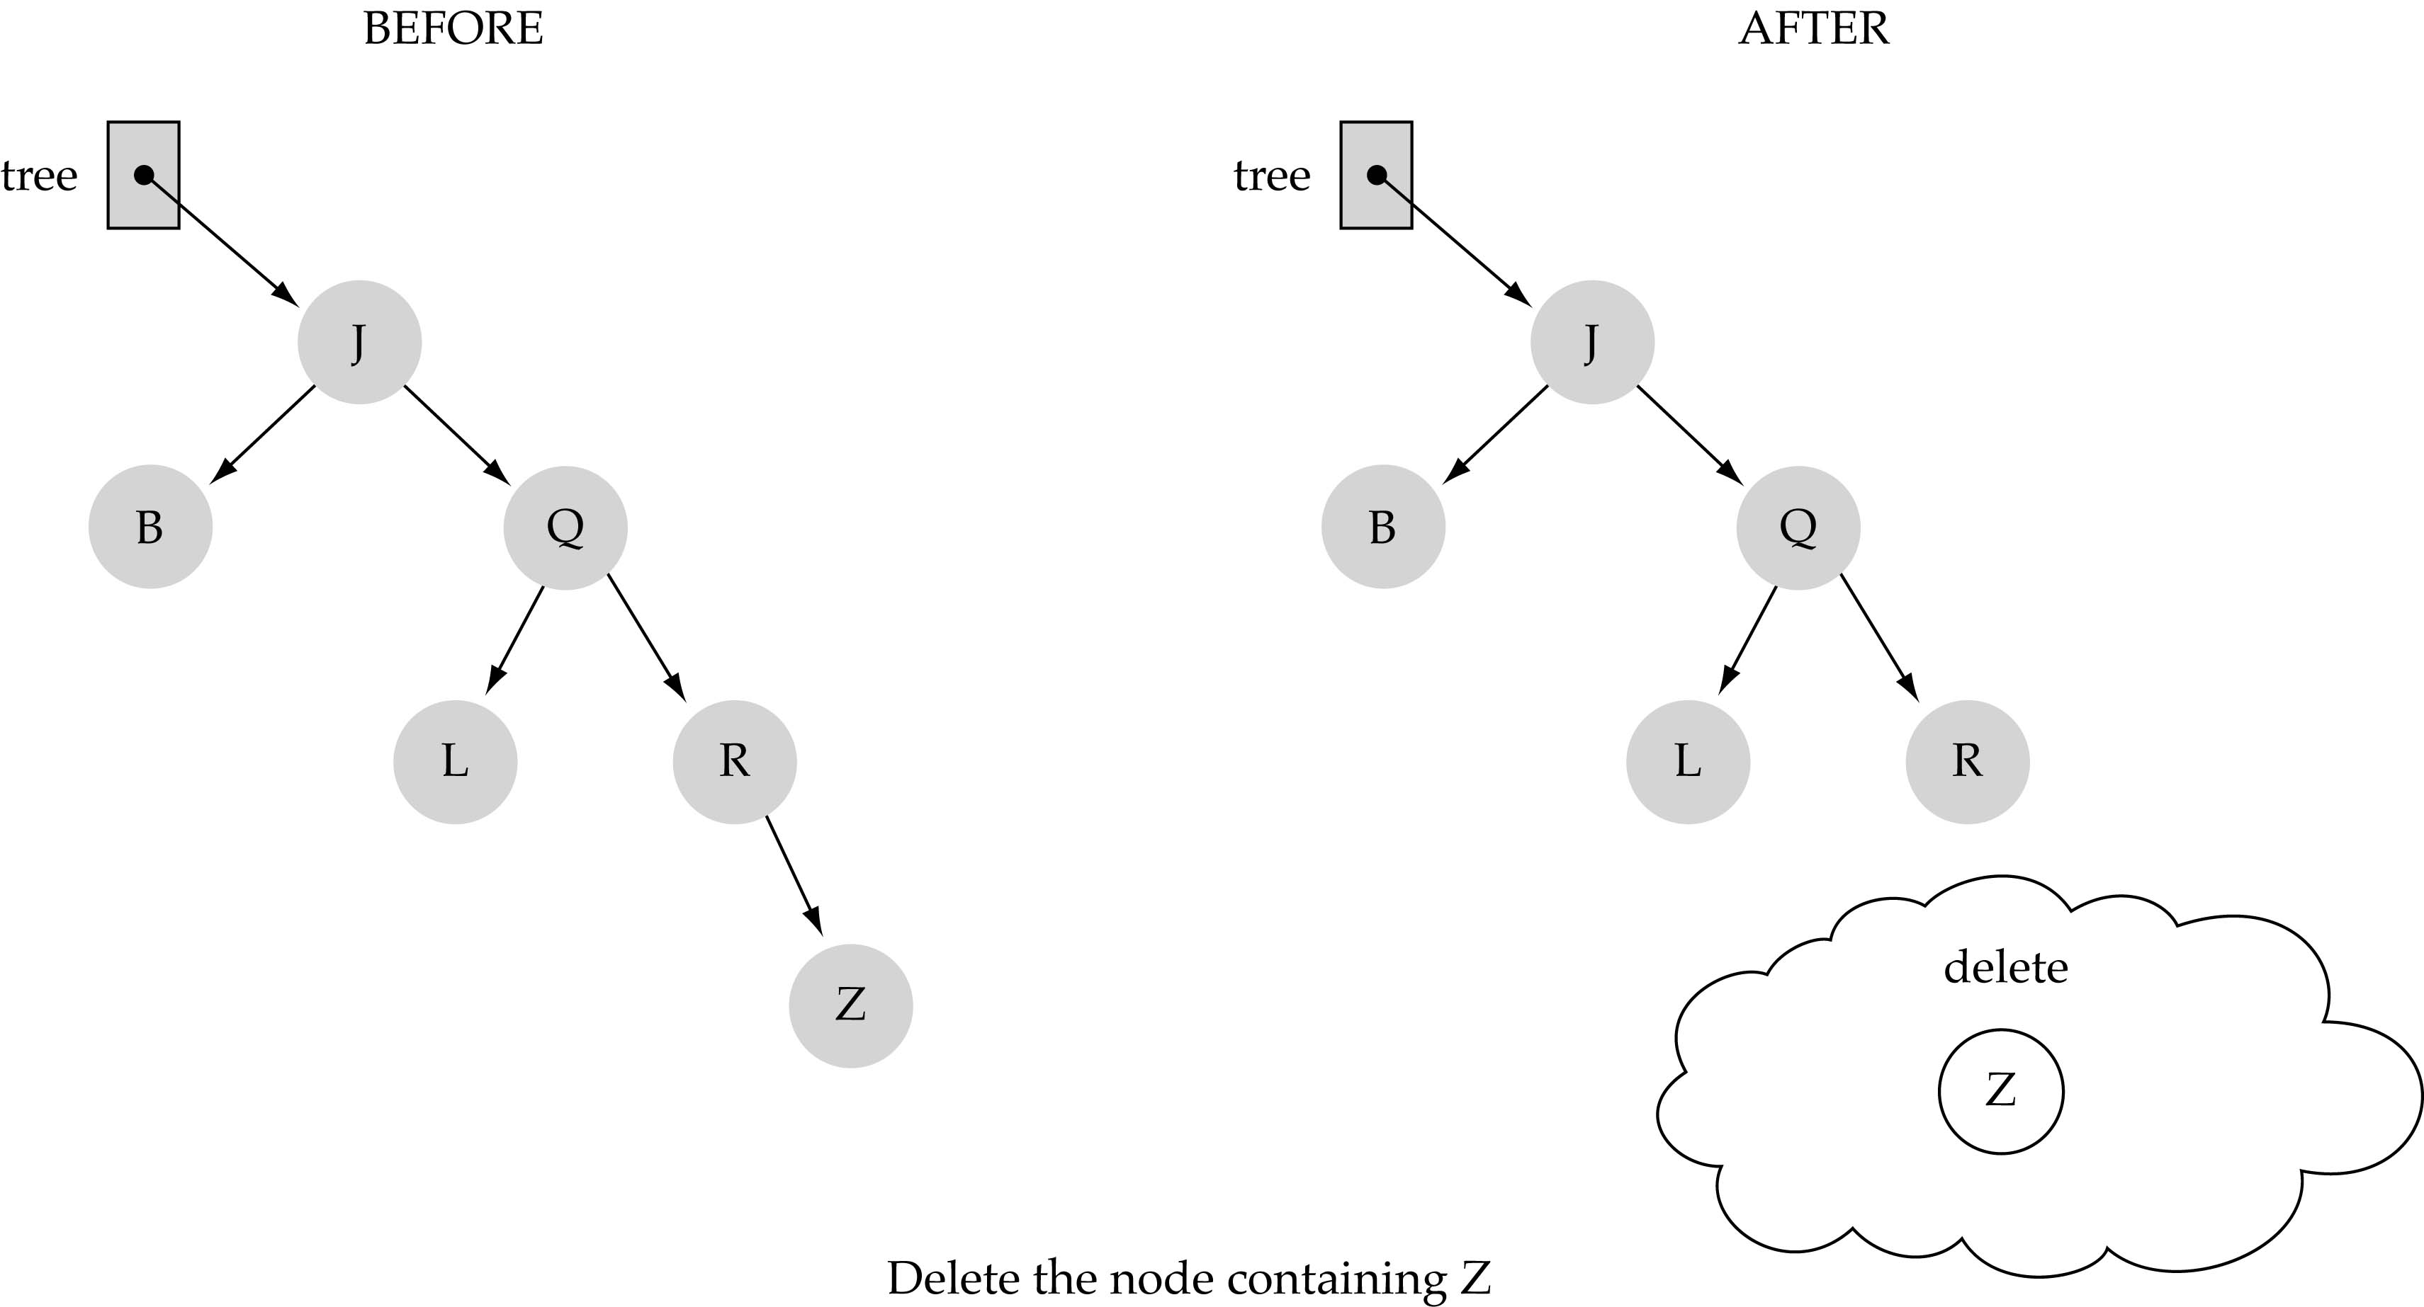
(1) Deleting a leaf

Slide 31
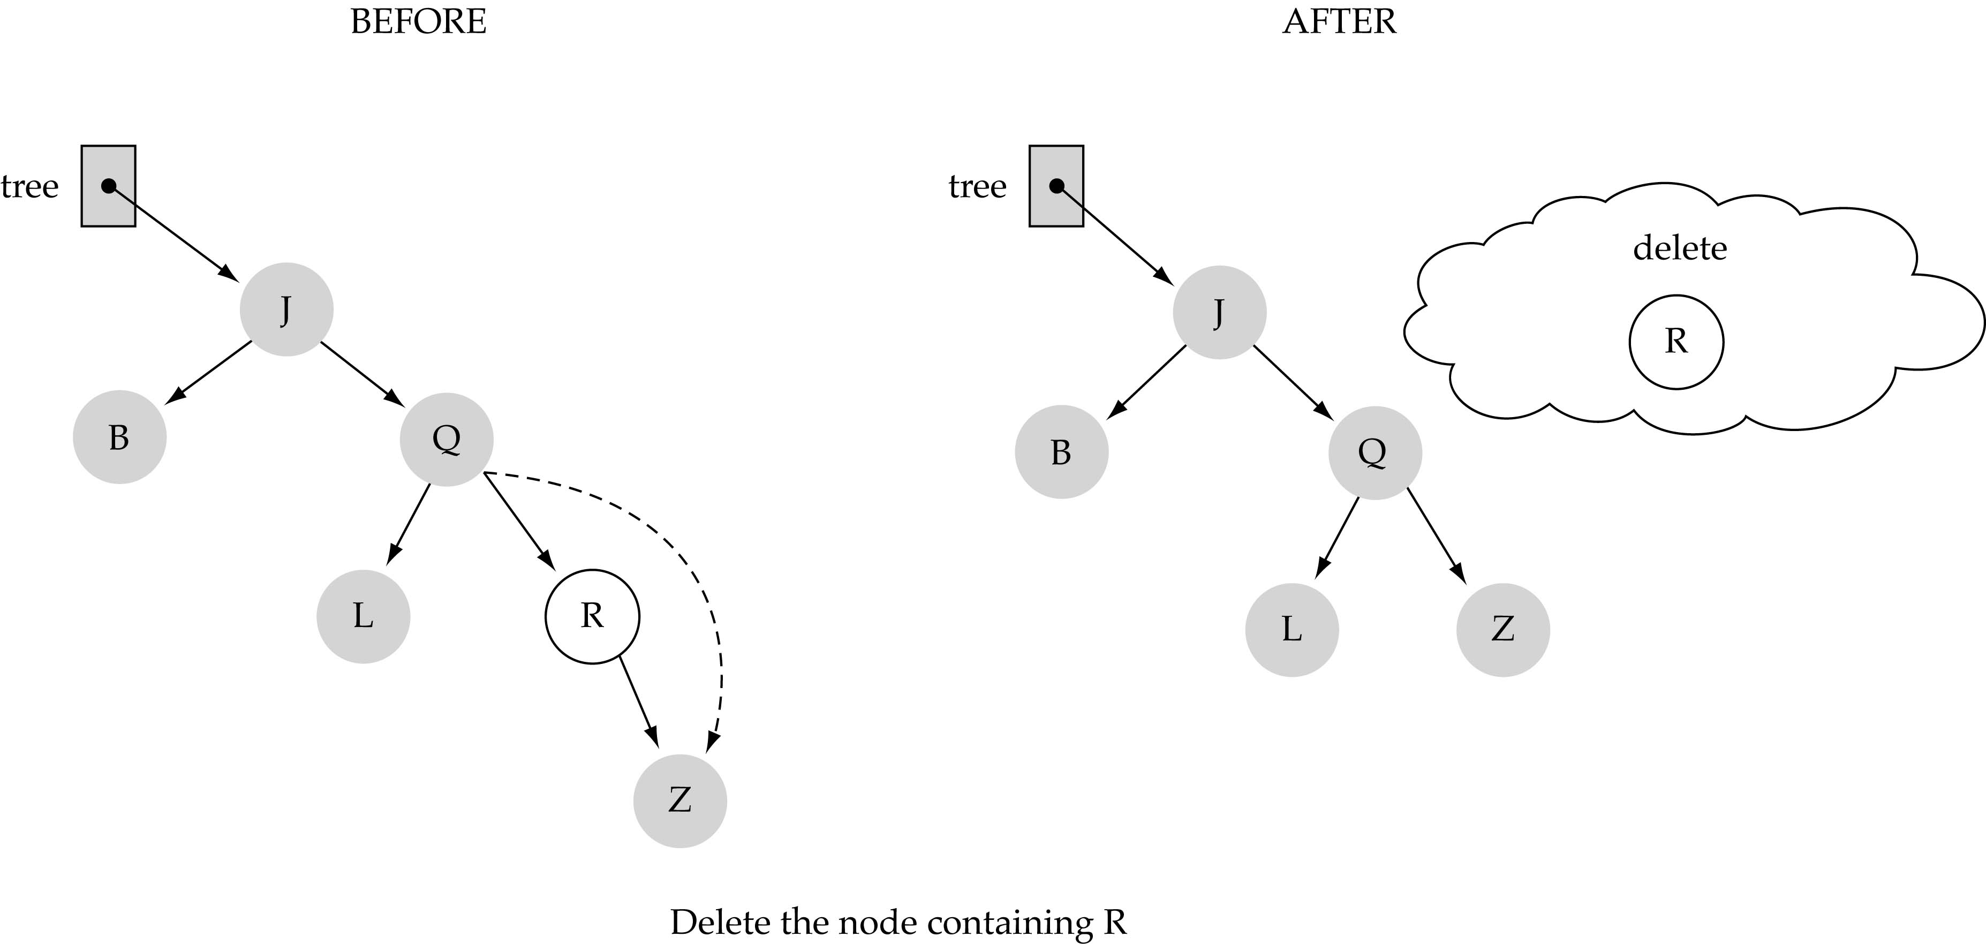
(2) Deleting a node with only one child

Slide 32
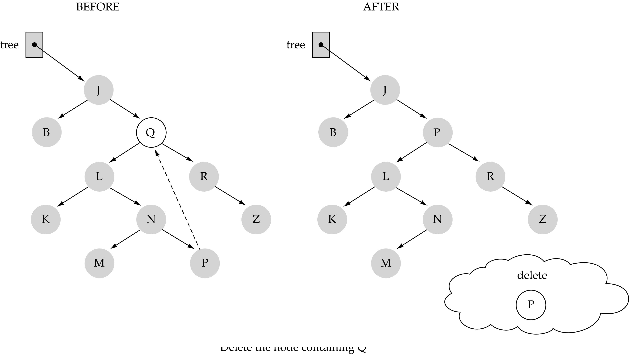
(3) Deleting a node with two children

Slide 33
(3) Deleting a node with two children (cont.)
Find predecessor in order (i.e., rightmost node in the left subtree)/ successor in order (i.e., leftmost node in the right subtree)
Swap the data of the node to be deleted with predecessor's / successor’s data
Delete predecessor/successor node

Slide 34
LATIHAN:
Buatlah BST berdasarkan angka berikut secara berturut-turut: 23, 53, 85, 40, 35, 11, 39, 72, 63, 69, 96. Tuliskan dalam langkah per langkah!
Lakukan pre-order, in-order, dan post-order dari BST tersebut.

Slide 35
References
Tjokorda Agung Budi Wirayuda, “PI1043 Struktur Data: Struktur Data Tree”.
Shelvie Nidya Neyman, “Struktur Data Tree”. Slide Struktur Data Program Diploma IPB
Denny, “Struktur Data & Algoritme - Tree”, Fakultas Ilmu Komputer Universitas Indonesia 2001
Cormen, T.H et all, “Introduction to Algorithms”, 2nd edition, Mc-Graw Hill Book, 2001
Images http://www.btechsmartclass.com/data_structures/tree-terminology.html
Hargrove, J. “The AVL Tree Rotations Tutorial”. 2007.
Riera, J. “AVL Trees Example”. 2001.

